Slide 1

Lecture 2
NUMERICAL QUADRATURE
JOHN L. JUNKINS & ROBYN M. WOOLLANDS
Five Part Lecture Series
Picard-Chebyshev Numerical Integration
Applications in Astrodynamics
Texas A&M University
Department of Aerospace Engineering
College Station, TX 77840
Spring 2017

Slide 2

JUNKINS & WOOLLANDS
Picard-Chebyshev Lecture Series
#2 Numerical Quadrature
FIVE PART LECTURE SERIES
Lecture | Title | Presenter
1 | Orthogonal Approximation | Junkins
2 | Numerical Quadrature | Junkins
3 | Picard Chebyshev Methods & Theoretical Convergence | Woollands
4 | Accelerated Picard Iteration & Adaptive Segmentation | Woollands
5 | Gravity Approximations | Junkins
2

Slide 3
JUNKINS & WOOLLANDS
Picard-Chebyshev Lecture Series
#1 Orthogonal Approximation
CONTENTS
Newton-Cotes & Gaussian Quadrature
Path Approximation versus Numerical Quadrature
Path Approximation via Chebyshev Polynomial Qudrature
Example
3

Slide 4
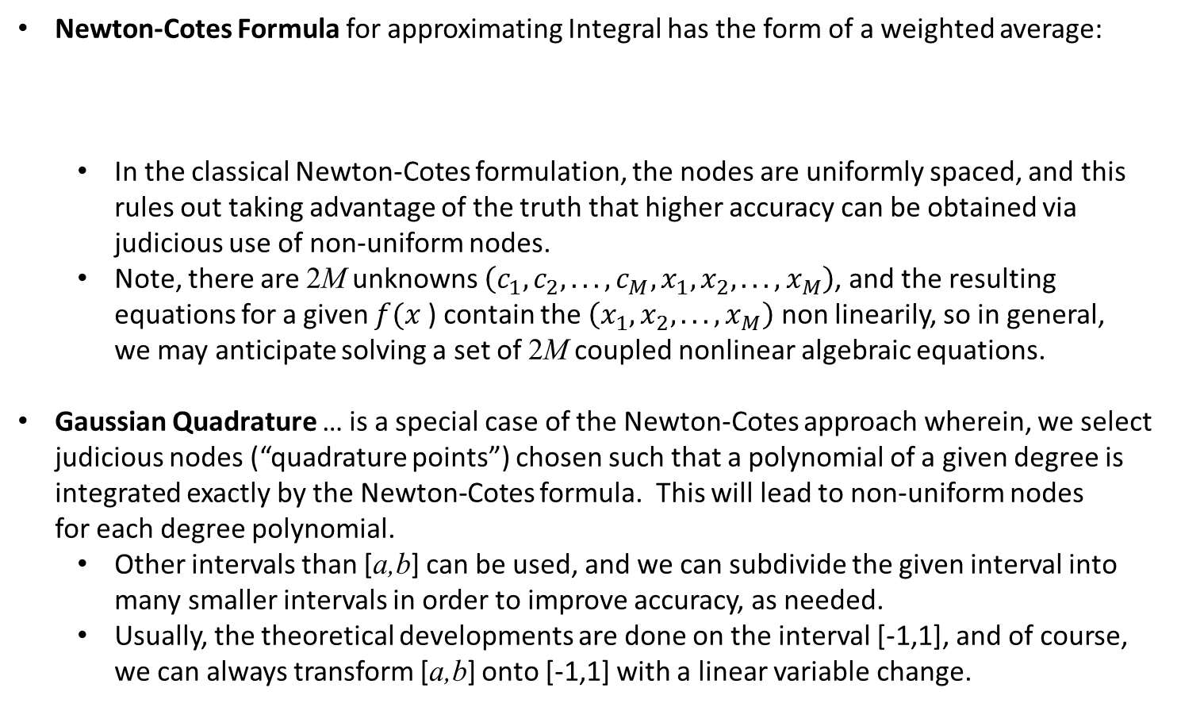
JUNKINS & WOOLLANDS
Picard-Chebyshev Lecture Series
#2 Numerical Quadrature
NEWTON-COTES AND GAUSSIAN QUADRATURE
Newton-Cotes Formula for approximating Integral has the form of a weighted average:
In the classical Newton-Cotes formulation, the nodes are uniformly spaced, and this rules out taking advantage of the truth that higher accuracy can be obtained via judicious use of non-uniform nodes.
Note, there are 2M unknowns $\left(c_{1},c_{2},...,c_{M},x_{1},x_{2},...,x_{M}\right)$, and the resulting equations for a given $f(x$) contain the $\left(x_{1},x_{2},...,x_{M}\right)$ non linearily, so in general, we may anticipate solving a set of 2M coupled nonlinear algebraic equations.
Gaussian Quadrature … is a special case of the Newton-Cotes approach wherein, we select judicious nodes (“quadrature points”) chosen such that a polynomial of a given degree is integrated exactly by the Newton-Cotes formula. This will lead to non-uniform nodes for each degree polynomial.
Other intervals than [a,b] can be used, and we can subdivide the given interval into many smaller intervals in order to improve accuracy, as needed.
Usually, the theoretical developments are done on the interval [-1,1], and of course, we can always transform [a,b] onto [-1,1] with a linear variable change.
4

Slide 5

JUNKINS & WOOLLANDS
Picard-Chebyshev Lecture Series
#2 Numerical Quadrature
GAUSSIAN QUADRATURE
Consider the Newton-Cotes formula
Let us set M=2, and seek to determine the four unknowns $\left(c_{1},c_{2},x_{1},x_{2}\right)$ such that the Newton-Cotes formula is exact for the four polynomials:
Note that these four requirements will give us four equations in four unknowns:
These equations are satisfied by $c_{1}=1,c_{2}=1, x_{1}=−\frac{1}{\sqrt{3}},x_{2}$=$\frac{1}{\sqrt{3}}$, so this Gaussian Quadrature formula exactly integrates a cubic polynomial over the interval [-1,1] :
Likewise a Gaussian Quadrature formula that exactly integrates a quantic polynomial over the interval [-1,1] can be shown to be:
5

Slide 6
JUNKINS & WOOLLANDS
Picard-Chebyshev Lecture Series
#2 Numerical Quadrature
PATH APPROXIMATION VS NUMERICAL QUADRATURE
In a significant family of problems, we have a differential equation of the form
Obviously, for an integrable f(t) , the differential equation is fully equivalent to the integral
equation
Thus we see that solving a differential equation where f(t) is a general function (or an accurate approximation of a given single valued general function) is closely related to the foregoing developments on quadrature. However, it is significant that we may have a variable upper limit, rather than a fixed limit, and that instead of just a numerical value to approximate the integral over fixed limits, we may desire an analytically attractive approximation of the trajectory x(t) expressed in terms of “nice” algebraic functions. Obtaining not just a numerical value of the integral (i.e., numerical quadrature), but rather
an algebraic expression that accurately approximates the integral for all infinity of t values
in the interval of interest is central to the path approximation methods we discuss below.
Obviously, specific t values can be substituted and a path approximation formula will give
numerical quadrature result over any interior subinterval as a special case.
6

Slide 7

JUNKINS & WOOLLANDS
Picard-Chebyshev Lecture Series
#2 Numerical Quadrature
PATH APPROXIMATION VIA CHEBYSHEV POLYNOMIAL QUADRATURE
(CLENSHAW-CURTIS QUADRATURE)
Consider the problem posed on the previous page with the interval$[−1≤t≤1]$, we have
a differential equation of the form
Suppose f(t) is smooth and single-valued, but is a messy (“ugly”) function not found in your standard integral tables (or is not integrable by your favorite symbol manipulator).
We can approximate the integrand in an infinity of ways as a linear combination of basis functions that are easily integrated. If we do least square approximation to determine the
coefficients, of the basis functions we in general must invert a matrix that may be high
dimensioned if we desire high accuracy. To avoid this dilemma, we can utilize any set of
orthogonal functions. One attractive set are the Chebyshev orthogonal polynomials.
So we write the approximation of the integrand and integrate term-by-term to get
Now, we know from Lecture 1 that
8

Slide 8

JUNKINS & WOOLLANDS
Picard-Chebyshev Lecture Series
#2 Numerical Quadrature
PATH APPROXIMATION VIA CHEBYSHEV POLYNOMIAL QUADRATURE
(CLENSHAW-CURTIS QUADRATURE)
As developed in Lecture 1, the resulting series for x(t) can also be written as a Chebyshev
polynomial
The coefficient vector $β\left(t\right)$ can be compactly expressed in matrix notation as
where
Indefinite Integral Operator:
Definite Integral Operator:
8

Slide 9
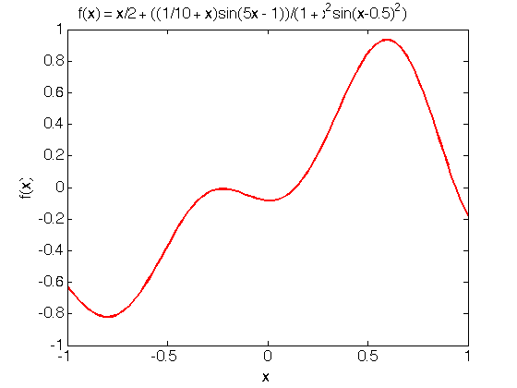
JUNKINS & WOOLLANDS
Picard-Chebyshev Lecture Series
#2 Numerical Quadrature
THE “UGLY” TEST FUNCTION 1
9

Slide 10
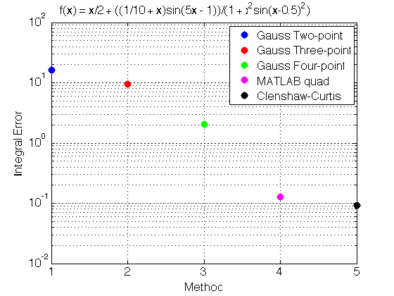
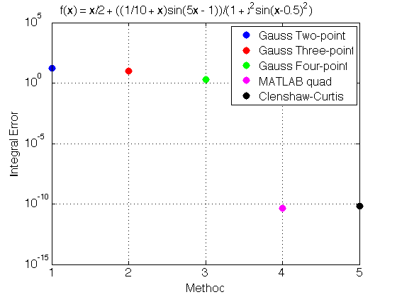
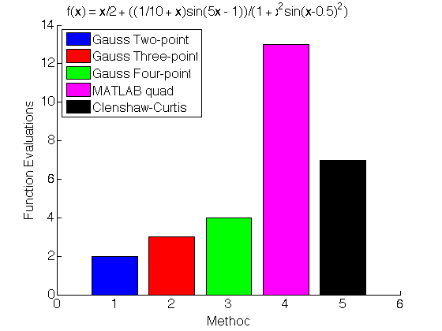
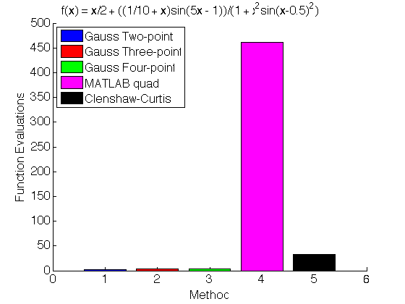
JUNKINS & WOOLLANDS
Picard-Chebyshev Lecture Series
#2 Numerical Quadrature
QUADRATURE COMPARISON 1 – LOW AND HIGH ACCURACY
Low Accuracy
High Accuracy
10

Slide 11
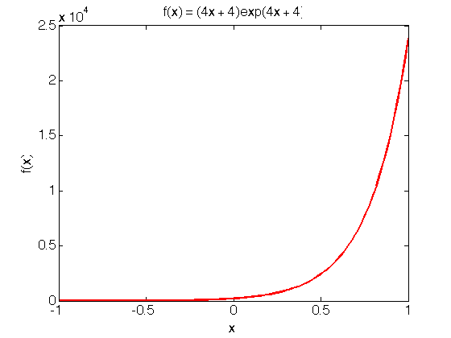
JUNKINS & WOOLLANDS
Picard-Chebyshev Lecture Series
#2 Numerical Quadrature
QUADRATURE COMPARISON 2: EASIER FUNCTION
11

Slide 12
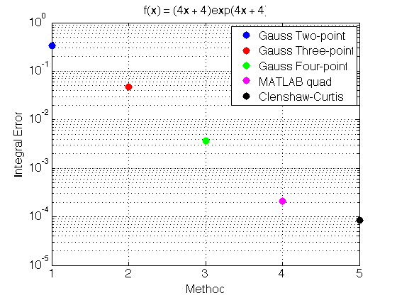
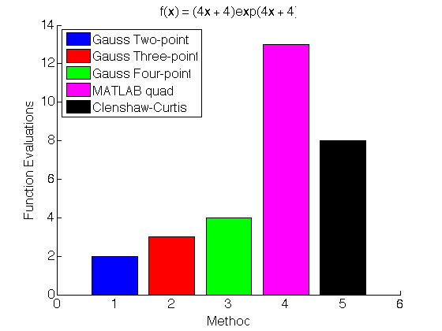
JUNKINS & WOOLLANDS
Picard-Chebyshev Lecture Series
#2 Numerical Quadrature
QUADRATURE COMPARISON 2 – LOW AND HIGH ACCURACY
Low Accuracy
High Accuracy
Conclusion based on limited experimentation: Clenshaw-Curtis (Chebyshev) integration “wins” by orders of magnitude for high precision integrals (>6 digits), Gaussian Quadrature “wins” for low precision (<3 digits) integrals. Also note, the result of Gaussian Quadrature is a number, the result of Clenshaw-Curtis integration is a function for a variable upper limit of integration.
12

Slide 13
JUNKINS & WOOLLANDS
Picard-Chebyshev Lecture Series
#2 Numerical Quadrature
REFERENCES
Boyd, John P., Chebyshev and Fourier spectral methods, Courier Corporation, 2001.
Hildebrand, Francis Begnaud, Introduction to numerical analysis, Courier Corporation, 1987.
Ma, J., Rokhlin, V., and Wandzura, S., Generalized Gaussian quadrature rules for systems of arbitrary functions, SIAM Journal on Numerical Analysis 33.3 (1996): 971-996.
Piessens, Robert, Modified Clenshaw-Curtis integration and applications to numerical computation of integral transforms, Numerical integration, Springer Netherlands, 1987: 35-51.
Junkins, J., Bani Younes, A., Woollands, R., Bai, B. Orthogonal Approximation in Higher Dimensions: Applications in Astrodynamics, ASS 12-634, JN Juang Astrodynamics Symp, 2012.
Bani-Younes, A., Orthogonal Polynomial Approximation in Higher Dimensions: Applications in Astrodynamics. PhD thesis, Department of Aerospace Engineering, Texas A&M University, College Station, TX, 2013.
13

